Slide 1
Personality
Define Personality
Types of personality
Cluster of personality

Slide 2



definition
www.tuf.edu.pk
unioffaisalabad
The combination of characteristics or qualities that form an individual's distinctive character.

Slide 3
www.tuf.edu.pk
unioffaisalabad
Personality refers to the enduring characteristics and behavior that comprise a person's unique adjustment to life, including major traits, interests, drives, values, self-concept, abilities, and emotional patterns.

Slide 4
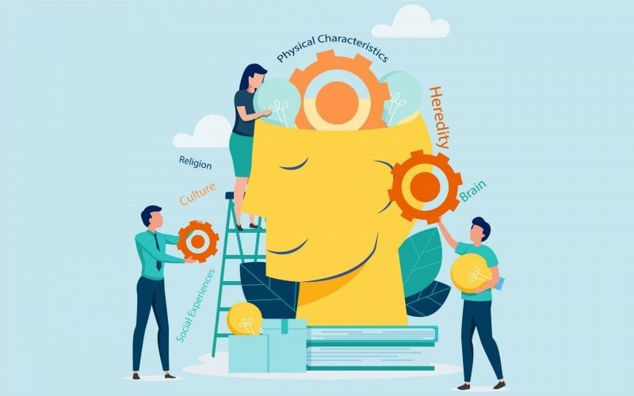
DETERMINENTS OF PERSONALITY
www.tuf.edu.pk
unioffaisalabad

Slide 5
www.tuf.edu.pk
unioffaisalabad
There are four major determinants of personality:
Biological/Physical Determinants: Hereditary and physical features
Social Determinants: Sociological aspects related to the community and his/her role in the community
Psychological Determinants: Behaviour, emotions, sentiments, thought patterns and complexes of an individual
Intellectual Determinants: Values, Humour, Morality, etc.

Slide 6
TYPES OF PERSONALITY
www.tuf.edu.pk
unioffaisalabad
Realistic (Doer)
Someone who likes to work mainly with their hands by making and fixing things, assembling or operating equipment. They sometimes prefer working outdoors and find joy in a career that performs various manual labor. The Realistic individual works well with tools, machines, and mechanical drawings. Valuing practical things they can see and touch, they often see themselves as practical, mechanical, and goal oriented.

Slide 7
www.tuf.edu.pk
unioffaisalabad
Investigative (Thinker)
The most analytical of the six personalities, this detail oriented group loves to study and solve math or science-related problems. They aren’t skilled negotiators but work best in a career choice that lets them work with others who are grounded. They see themselves as precise, intellectual, and goal oriented people that like to be acknowledged for their achievements.

Slide 8
www.tuf.edu.pk
unioffaisalabad
Artistic (Creator)
This group of individuals values others who are expressive and independent with an openness to experience. They naturally admire the creative arts, including writing and music, and have high levels of creativity. They see themselves as expressive and original and prefer to avoid a career choice that requires highly ordered or repetitive activities. They enjoy working in groups, but only if they are allowed expressive freedom and are encouraged to share their ideas.

Slide 9
www.tuf.edu.pk
unioffaisalabad
Social (Helper)
Those with a Social personality type like to “dominate” their environment. This is the most common category of the six, and many people have traits of this category along with their others. They particularly value providing services for others and enjoy a career choice that enables them to work closely with people. Their ideal working conditions are with other people who are also trustworthy, helpful, and show appreciation.

Slide 10
www.tuf.edu.pk
unioffaisalabad
Enterprising (Persuader)
Enterprising personalities are the people you want on your team when it comes to getting things done. They’re energetic, confident and assertive, and they don’t shy away from a challenge. They can be extroverted or introverted, but they all share some common traits: they’re ambitious, hard-working and willing to try new things.

Slide 11
www.tuf.edu.pk
unioffaisalabad
Conventional (Organizer)
A member of this group would prefer a career choice where they can work with numbers, records, or machines. They enjoy repetitive tasks done in an orderly fashion and like to avoid ambiguous activities. They see themselves as organized and good at following directions. They value success in business and enjoy working with other people. However, they do best in small, systematic groups where they know their responsibilities.

Slide 12
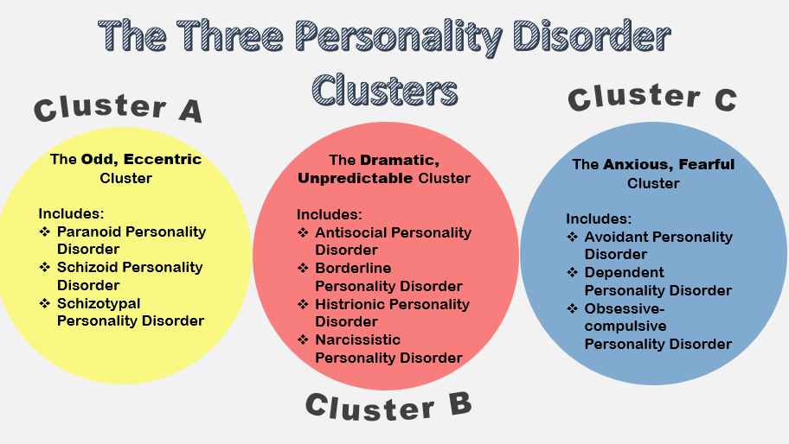
PERSONALITY DISORDER
www.tuf.edu.pk
unioffaisalabad

